Slide 1
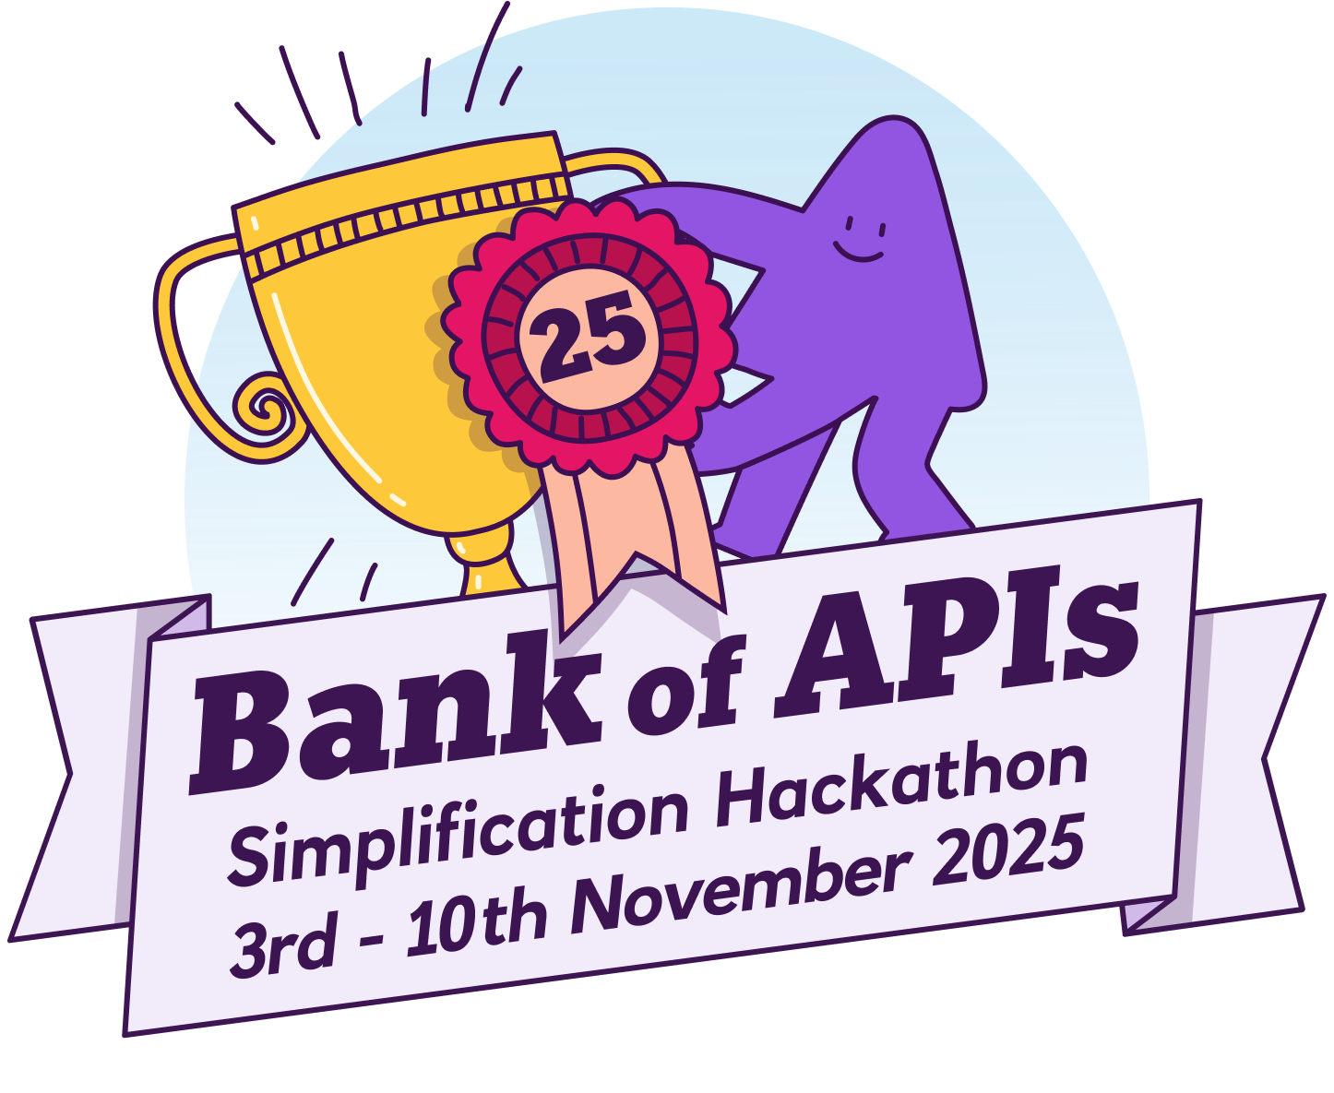
Meet our team: FinFusion
Yashwini Nathwani
Sai Deepa Anthati
Nivedita Indore
Tasleem Shashavali
Bhavna Magendiran
Avidha
Karan Vashisth, Mentor
WoW - Principal Engineer (DCB, HBO & BOA Retail Digital X)
Notes:
YASHWINI
- Hello everyone! We are team FinFusion. The problem we're addressing today is something we, as developers working across various projects, have observed multiple times. And frankly, it’s costing us time and money.

Slide 2

The critical problem:
What’s hiding in the shadows?
Notes:
YASHWINI
Have you ever come across any APIs and wondered, “Wow, we pay the maintenance bill for APIs that no one has called since the last office party?” Or maybe you’ve seen too many services wearing the exact same outfit and thought, “Our APIs are suffering from a wardrobe malfunction” (while changing slide) Our current microservice environment is complex, and these are real symptoms of three critical problems that impact our velocity and risk profile.

Slide 3
The critical problem:
What’s hiding in the shadows?
Waste (Zombie APIs)
💀
Risk (High-Impact APIs)
Duplication (Redundant APIs)
Notes:
YASHWINI
The first problem is Waste, caused by what we call Zombie APIs. These are older, unused, or rarely used APIs that still consume valuable resources: maintenance effort, unnecessary testing cycles, and infrastructure costs. They are dead code, but they still generate a bill.

Slide 4
The critical problem:
What’s hiding in the shadows?
Waste (Zombie APIs)
⚠️
Risk (High-Impact APIs)
Duplication (Redundant APIs)
Notes:
YASHWINI
The second problem is Risk, centred around our High-Impact APIs. These are the APIs that are called heavily and have multiple consumers. When these APIs have weak or outdated documentation, they become a critical single point of failure and slow down every team that tries to integrate with them.

Slide 5
The critical problem:
What’s hiding in the shadows?
Waste (Zombie APIs)
⚖️
Risk (High-Impact APIs)
Duplication (Redundant APIs)
Notes:
YASHWINI
The final problem is Duplication Because different teams are tackling similar business needs, similar APIs are being built across different services. This leads to redundant development, confusing discovery for new developers, and a difficulty in consolidating functions.

Slide 6

The need for Action
Mostly discovered randomly
Manual effort
Time-consuming
Complex across multiple projects
Notes:
TASLEEM
We have observed that these issues are mostly discovered randomly, if at all. Identifying these issues is currently a time-consuming, manual, and reactive process across disparate projects. The bottom line is: We need to stop randomly stumbling upon problems and start shining a light on them. (CHANGE SLIDE) That is why we have prototyped a solution called API-Glow.

Slide 7

Uncovering Usage, Impact, and Duplication Across All Microservices
Notes:
TASLEEM
API-Glow solves these challenges by providing a centralized, automated dashboard that combines real-time usage metrics with powerful similarity detection.

Slide 8

Uncovering Usage, Impact, and Duplication Across All Microservices
Automated Insights
Usage-Driven Prioritization
Guiding Standardization
Notes:
TASLEEM: It consists of automated insights which help eliminate manual auditing by continuously analyzing usage logs and API metadata across the organization.

Slide 9
Uncovering Usage, Impact, and Duplication Across All Microservices
Automated Insights
Usage-Driven Prioritization
Guiding Standardization
Notes:
TASLEEM
Usage-Driven Prioritization visually pinpoints where development effort is needed most, that is, fixing high-impact APIs or least, that is for the retiring low-impact APIs

Slide 10
Uncovering Usage, Impact, and Duplication Across All Microservices
Automated Insights
Usage-Driven Prioritization
Guiding Standardization
Notes:
TASLEEM
Also, it supports architectural goals of API consolidation and standardization.

Slide 11
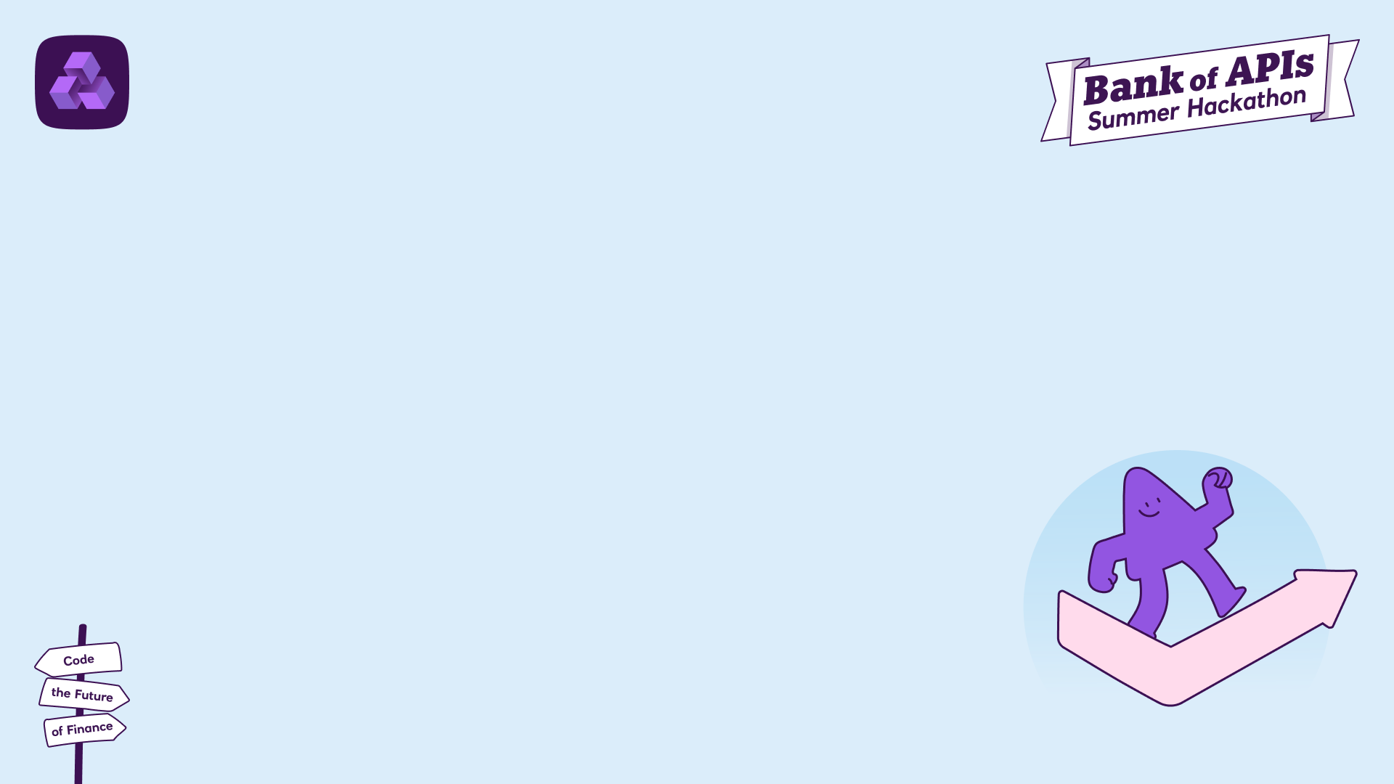
DEMO
Notes:
AVIDHA
The core left-side visualization provides an immediate, intuitive view of API activity and importance in form of heatmap. APIs are mapped and colored based on Impact Score which is a metric combining calls and consumers.
Red Hot: Quickly identify APIs that are heavily used and critical (high risk if documentation is poor).
Ice Cold: Instantly flag Zombie APIs (low usage, low consumer count) ready for deprecation or review.
For a clicked API, it instantly shows all similar APIs (e.g., similarity > 80%), highlighting opportunities to merge or deprecate.
This enables developers building a new API to check instantly if a highly similar, existing API can be reused instead.

Slide 12
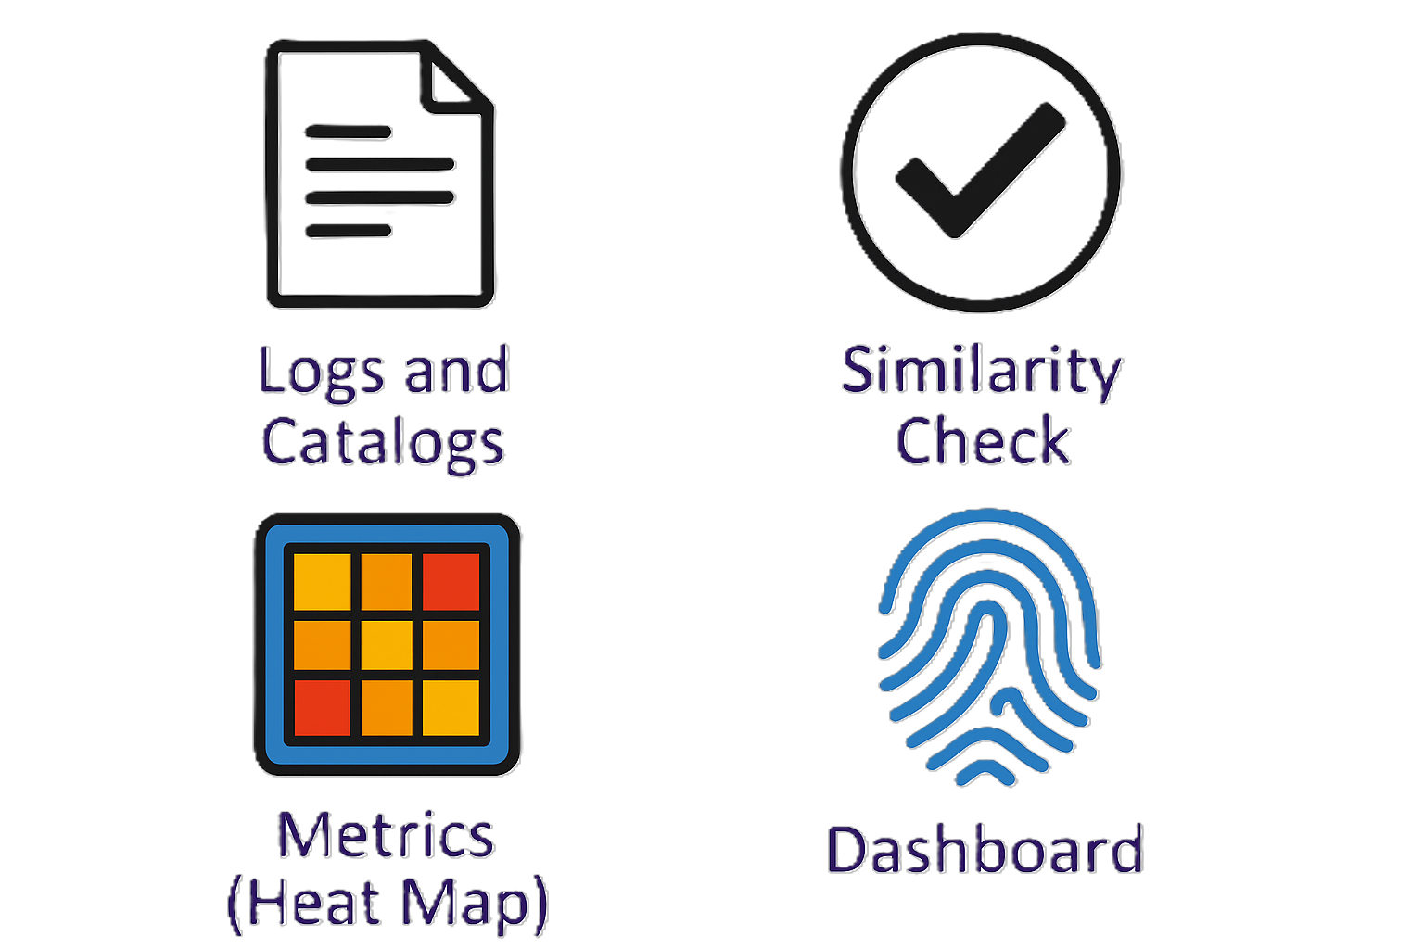


Architecture
Duplication Check
Metrics (API Impact Heat Map)
Logs and Catalogs
Normalize
Suggestions
Dashboard
API Fingerprint
Notes:
BHAVNA
So, our platform continuously collects API gateway logs and the API Catalogs. We ingest and normalize this data, then calculate usage metrics to power the heat map and generate API fingerprints. These fingerprints go through similarity scoring – anything above 0.8 gets highlighted as a duplication candidate. Based on that, we generate smart refactor suggestions. All this exposed via an internal API, and the dashboard visualizes this as a simple heatmap with actionable insights.

Slide 13
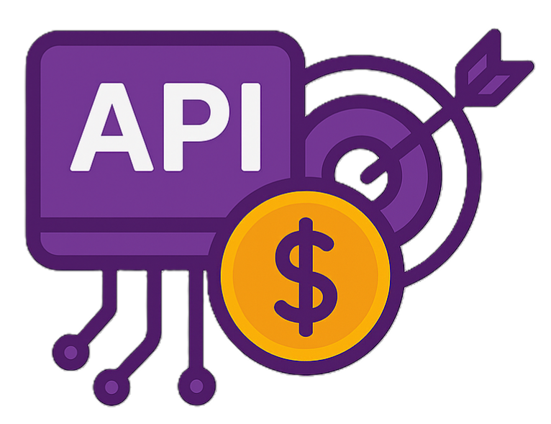


🚀 Key Benefits
IMPACT
Focus on high value APIs Reduce Operational Risks
EFFICIENCY
Remove Duplicates
Improved Governance
VELOCITY
Faster Refactor Choices
Better Developer Experience
Notes:
DEEPA
The core benefits fall into three buckets:
First – Impact: We help teams focus on the APIs that matter most and reduce operational risks by showing where the highest consumption and dependency is.
Second – Efficiency: by detecting duplicated early, we eliminate waste and improve governance standards across the API landscape.
And Third – Velocity: because we give refactor suggestions, developers can modernize faster and build on existing APIs instead of reinventing them – which accelerates delivery.

Slide 14
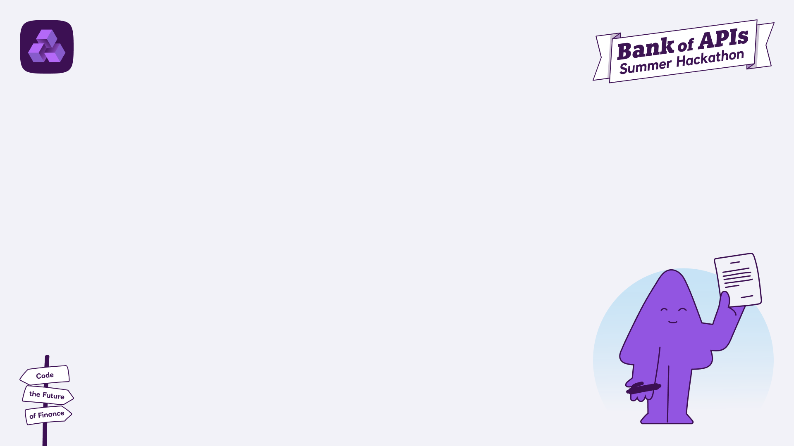
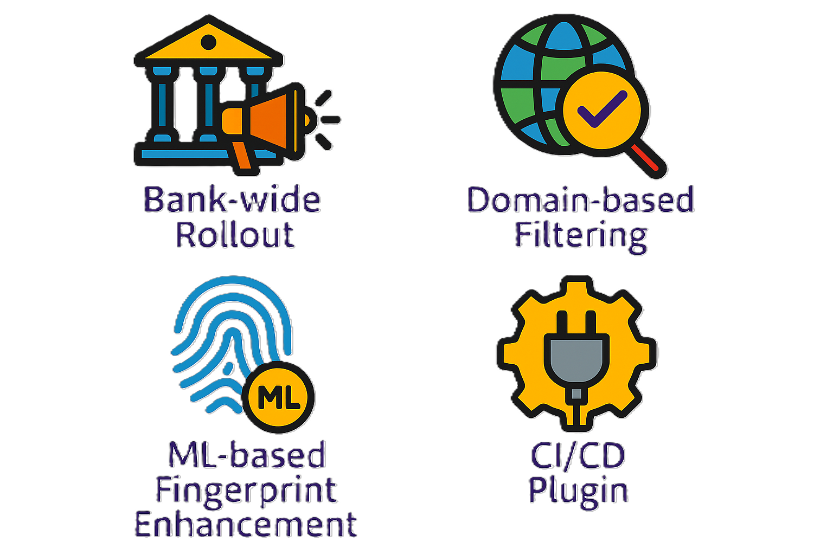

Future
Scope
Bank-wide Rollout
Domain-based Filtering
ML-based Fingerprint Enhancement
Knowing Your Consumers
Notes:
NIVEDITA
For future scope, we can roll out bank wide, so every domain benefits from consistent API hygiene. We can also introduce domain-based filtering, so platform owners can drill into specific areas like payments, lending, Cards and so on. Next, we can implement ML-based fingerprint models so that it becomes faster over time and auto learns patterns. Finally, we can extend this to “Know your consumers” – where we analyze which APIs consumers and thus helping in prioritizing API investments better.

Slide 15
Thank you!
Notes:
Thank you for your time, we can proceed to Q&A.

